Slide 1

The Car Chronicles: Unveiling Automotive Insights
Exploring data to understand vehicle identity and value
Notes:
AI-generated content may be incorrect. --- In this presentation, we will journey through the fascinating world of automotive data. We aim to understand car identity, value, and the hidden stories within the data that can provide insights into the automotive landscape.

Slide 2

Agenda of Our Automotive Journey
Introduction
A Glimpse Under the Hood
The Tale of Categorical Features
Visualizing the Numbers: A Histogram Expedition
Categorical Count: A Close-Up
Notes:
We'll begin with an introduction to our automotive journey and outline our goal of analyzing car identity and value. Then, we will dive into data inspection, categorical features, and visualization techniques to uncover trends and patterns within the data.

Slide 3
Introduction
Notes:
This section sets the stage for our exploration of automotive insights. We will discuss our motivations and objectives as we embark on this analysis of car data.

Slide 4

Our Automotive Journey
Importance of Data Analysis
Data analysis plays a crucial role in understanding vehicle performance and characteristics, impacting decision-making in the automotive industry.
Car Identities
Understanding car identities helps manufacturers and consumers differentiate vehicles, enhancing brand recognition and customer loyalty.
Market Value Insights
Uncovering market value insights allows stakeholders to make informed decisions on pricing, sales strategies, and investments within the automotive sector.
Notes:
Our journey in the automotive realm begins with recognizing the importance of data analysis in understanding vehicles. This journey will lead us to uncover invaluable insights about car identities and their market value.

Slide 5
Goal: Understanding Car Identity and Value
Factors of Car Identity
Understanding the unique characteristics that define a vehicle's identity, including design, brand, and technology.
Value Determinants
Analyzing the various factors that contribute to a car's market value, such as age, condition, and mileage.
Data Analysis Techniques
Employing data analysis methods to form a clearer understanding of what influences car identity and value.
Notes:
Our primary goal is to discern the factors that contribute to a car's identity and value. By analyzing various data points, we aim to form a clearer picture of what makes each vehicle unique.

Slide 6

Uncovering Stories Within the Data
Data as a Narrative
Data transcends mere numbers, weaving a narrative that reflects the story behind each data point, especially in automotive history.
Insights into History
Each data point provides valuable insights into the history of a car, contributing to understanding its evolution and significance.
Emotional Value of Data
Data evokes emotions by highlighting the journey of a car, connecting the audience to its value and impact on lives.
Notes:
Data is not just numbers; it tells a story. We will explore how each data point contributes to the narrative of the car, revealing insights into its history, value, and the emotions it evokes.

Slide 7
A Glimpse Under the Hood
Notes:
In this section, we will take a closer look at how we inspect and analyze the data that forms the basis of our insights into the automotive world.

Slide 8
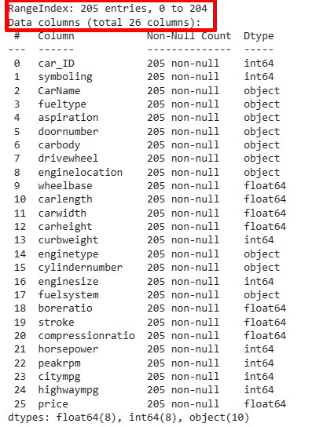
Initial Data Inspection
Understanding Data Structure
An initial inspection allows us to identify the structure of the dataset, including rows, columns, and data types.
Assessing Completeness
We evaluate the completeness of the data to identify any missing values or gaps that may affect analysis.
Evaluating Relevance
Determining the relevance of the data ensures that our analysis aligns with the intended goals and objectives.
Notes:
Before diving deeper, it's essential to conduct an initial inspection of the data. This step helps us understand the structure, completeness, and relevance of the data we will be analyzing.

Slide 9
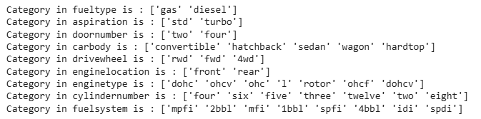
Examples of Car Characteristics
Make of the Car
The make of a car refers to the manufacturer brand, which influences the vehicle's features, performance, and image.
Model Variations
Each car model comes with its unique design, specifications, and features, affecting consumer preferences and choices.
Year of Manufacture
The year of manufacture is essential for evaluating a car's age, technology, and potential resale value.
Notes:
We will examine various characteristics of cars, such as make, model, year, and mileage. Each of these attributes plays a crucial role in defining a car's identity and market position.

Slide 10
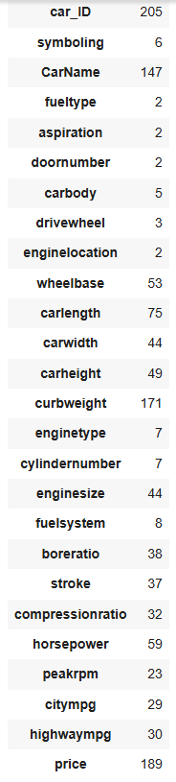
Ensuring Data Accuracy
Importance of Data Accuracy
Data accuracy is crucial for generating reliable insights, impacting decision-making and strategic planning.
Verification Methods
We utilize various verification methods to cross-check data, ensuring its credibility and reliability for analysis.
Validation Techniques
Validation techniques help confirm that data meets the necessary quality standards for meaningful insights.
Notes:
Data accuracy is vital for producing reliable insights. We will discuss the methods we employ to verify and validate our data, ensuring that our conclusions are based on sound information.

Slide 11
The Tale of Categorical Features
Notes:
Categorical features provide a narrative about the different types of cars and their classifications. This section will explore the significance of these features in our analysis.

Slide 12
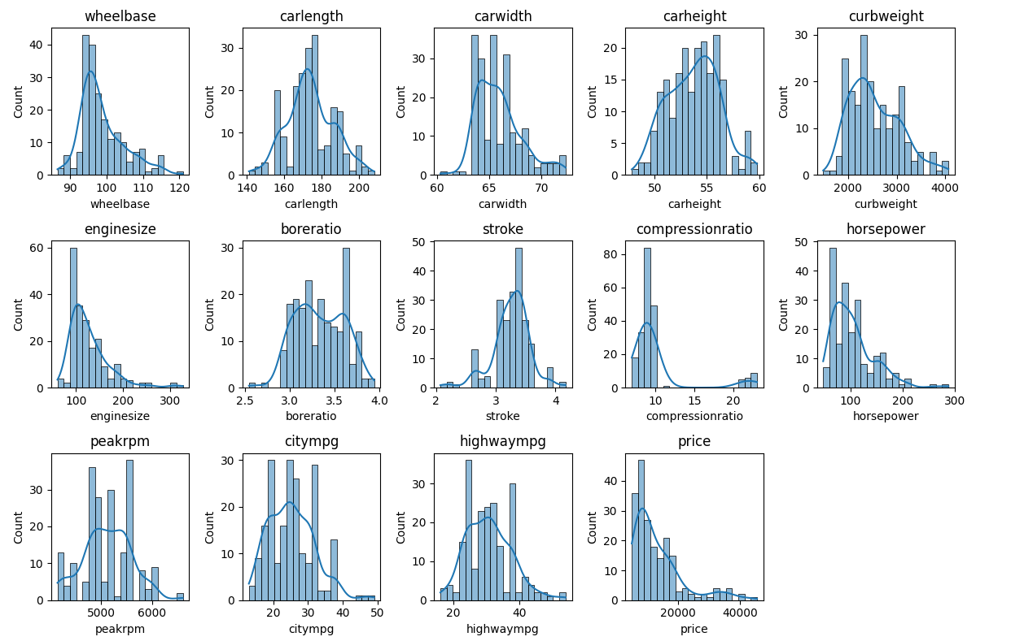
Analyzing Categorical Features
Categorical Features Overview
Categorical features include car brands, types, and colors, critical for market analysis.
Identifying Trends
Analyzing these categories allows us to identify trends and preferences in the automotive market.
Notes:
We will delve into how we analyze categorical features such as car brands, types, and colors. Understanding these categories helps identify trends and preferences in the automotive market.

Slide 13
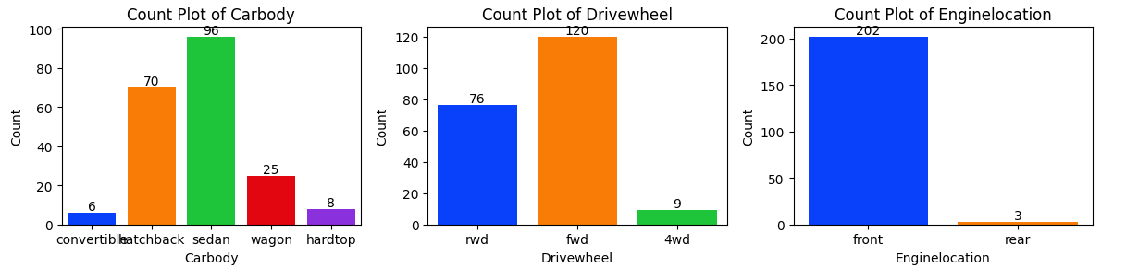
Examples of Categories
Sedans
Sedans are known for their sleek design and fuel efficiency, making them a popular choice among consumers.
SUVs
SUVs offer spacious interiors and off-road capabilities, appealing to families and adventure seekers alike.
Hybrids
Hybrids combine traditional fuel with electric power, catering to eco-conscious consumers looking for fuel efficiency.
Notes:
Examples of categories we will explore include sedans, SUVs, and hybrids. Each category represents a different segment of the market, reflecting consumer preferences and trends.

Slide 14
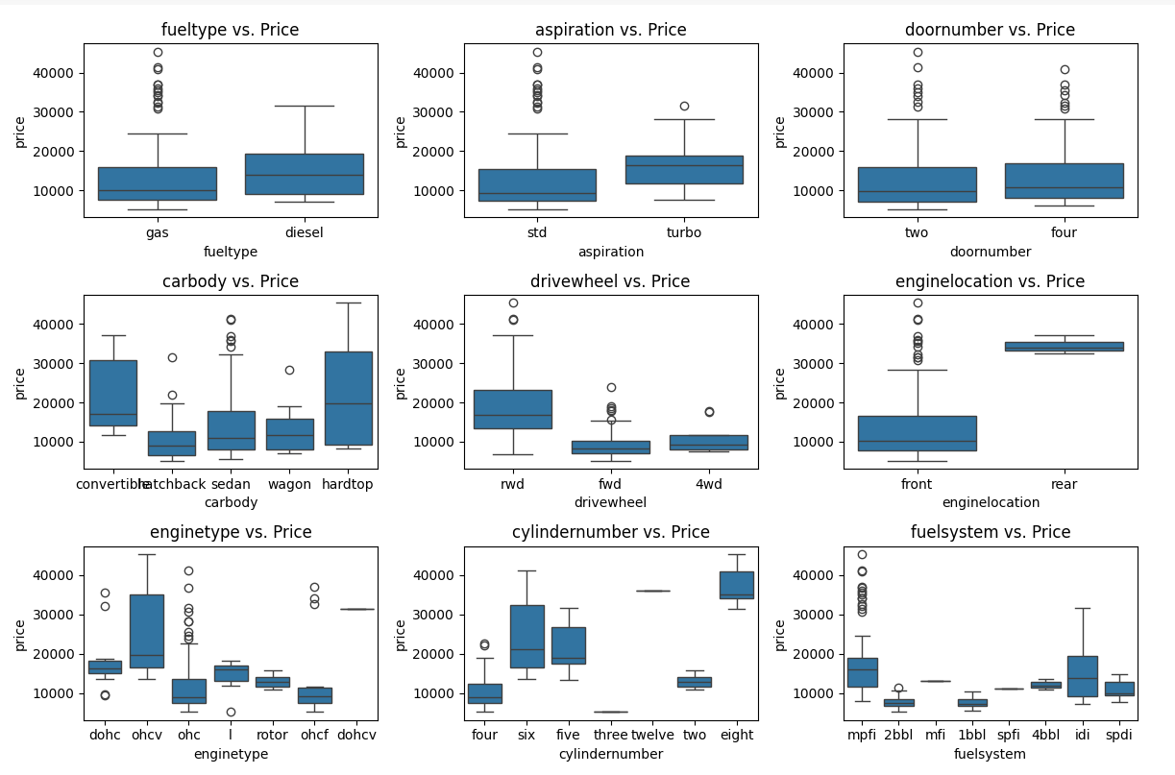
Revealing Car Diversity
Categorical Features Analysis
Analyzing categorical features helps us to identify and understand the diverse characteristics of vehicles in the market.
Market Dynamics Understanding
Understanding car diversity is essential for grasping market dynamics, including trends and consumer preferences.
Consumer Choices Insights
The diversity in the automotive industry directly influences consumer choices and purchasing decisions.
Notes:
By analyzing categorical features, we reveal the diversity in the automotive industry. This diversity is crucial for understanding market dynamics and consumer choices.

Slide 15
Visualizing the Numbers: A Histogram Expedition
Notes:
Visual representation of data helps us understand trends and distributions. In this section, we will utilize histograms to illustrate numerical feature distributions.

Slide 16

Understanding Numerical Feature Distribution
Numerical Feature Analysis
Analyzing numerical features like price and mileage helps understand the distribution of vehicles in the market.
Market Segmentation Insights
Insights gained from feature distribution can guide market segmentation strategies and targeted marketing efforts.
Notes:
We will examine how numerical features such as price and mileage are distributed across different vehicles. This overview will provide insight into market segmentation.

Slide 17
Examples of Numerical Features
Price Analysis
Price is a crucial numerical feature that significantly affects a car's market appeal and consumer purchasing decisions.
Horsepower Impact
Horsepower is another important numerical feature that influences a vehicle's performance and attractiveness to buyers.
Fuel Efficiency Metrics
Fuel efficiency is vital for modern consumers and impacts the overall value and appeal of a vehicle in today's market.
Notes:
We will analyze various numerical features, including price, horsepower, and fuel efficiency, to understand how these factors influence a car's market appeal.

Slide 18
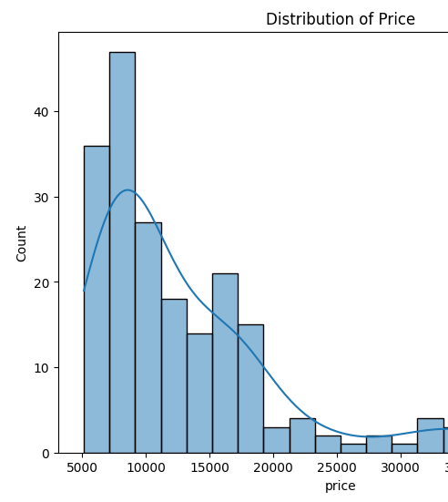
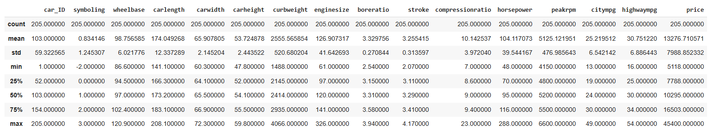
Focusing on Price Distribution
Importance of Price in Automotive
Price significantly influences consumer decisions in the automotive market, affecting sales and brand perception.
Identifying Trends and Outliers
Analyzing price distribution allows businesses to spot trends and outliers that can inform pricing strategies.
Notes:
Price is a critical factor in the automotive market. We will focus on visualizing the price distribution of vehicles to identify trends and outliers.

Slide 19
Categorical Count: A Close-Up
Notes:
This section emphasizes the importance of visualizing categorical data. By examining categorical counts, we can observe the prevalence of various features in the automotive dataset.

Slide 20
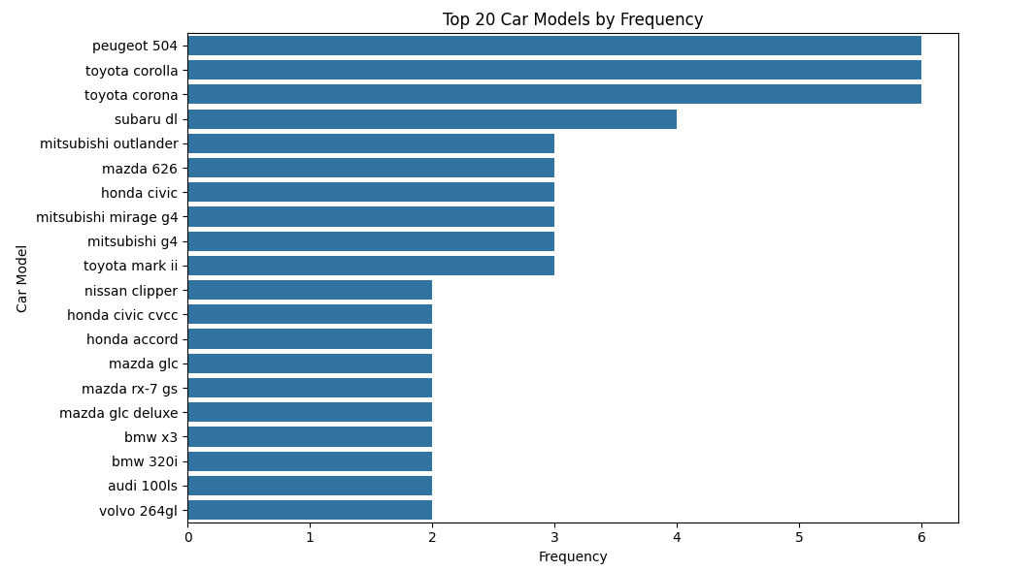
Visualizing Frequency of Categories
Understanding Frequency
Visualizing frequency helps identify the most common categories in any dataset, such as car types.
Bar Graph Representation
Using bar graphs allows for a clear comparison of different categories and their frequencies.
Insights from Data
Effective visualization provides insights that can guide decision-making and data analysis processes.
Notes:
We will explore how to visualize the frequency of different categories, allowing us to understand which car types are most common in the dataset.

Slide 21
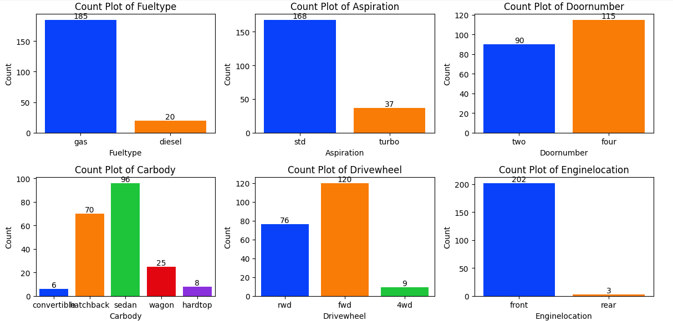
Observing Prevalence of Different Features
Feature Analysis Importance
Analyzing features like color and brand is crucial for understanding consumer preferences and improving product offerings.
Consumer Preferences Insights
Insights into consumer preferences can guide marketing strategies and product design to better meet market demands.
Market Trends Identification
Identifying market trends through feature prevalence helps businesses stay competitive and responsive to consumer needs.
Notes:
Analyzing the prevalence of different features such as color, brand, and type helps us gain insights into consumer preferences and market trends.

Slide 22
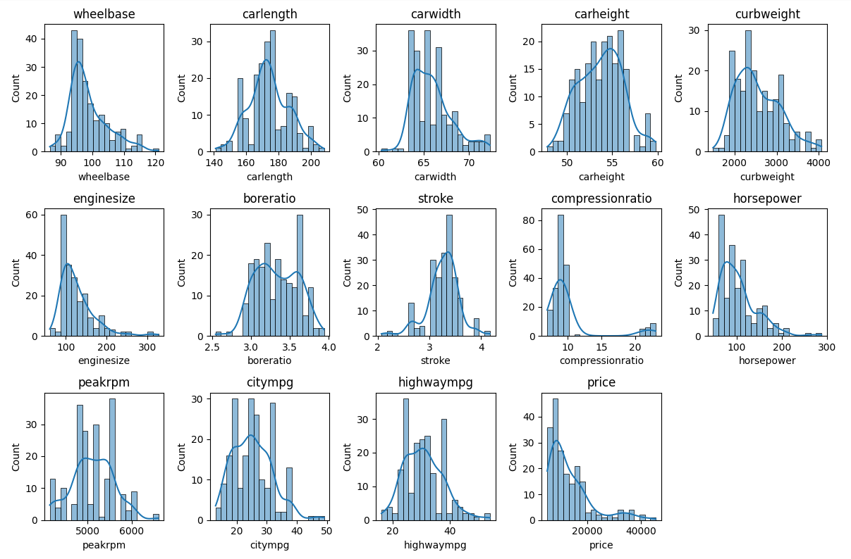
Conclusion
Insights into Car Identity
Our analysis has highlighted various aspects of car identity, helping us appreciate the uniqueness of each vehicle.
Understanding Vehicle Value
By examining automotive data, we gain insights into the value of different vehicles and what influences their worth.
Diversity in Automotive Landscape
Our exploration reveals the diversity within the automotive landscape, showcasing various makes, models, and their stories.
Notes:
In conclusion, our exploration of automotive data has unveiled valuable insights into car identity, value, and diversity. By leveraging data effectively, we can better understand the automotive landscape and the stories behind each vehicle.

Slide 23
Categorical Features Vs. Price: A Comparative Analysis
Notes:
This section focuses on how various categorical features of cars relate to their prices, providing a comparative analysis of different vehicle categories.

Slide 24
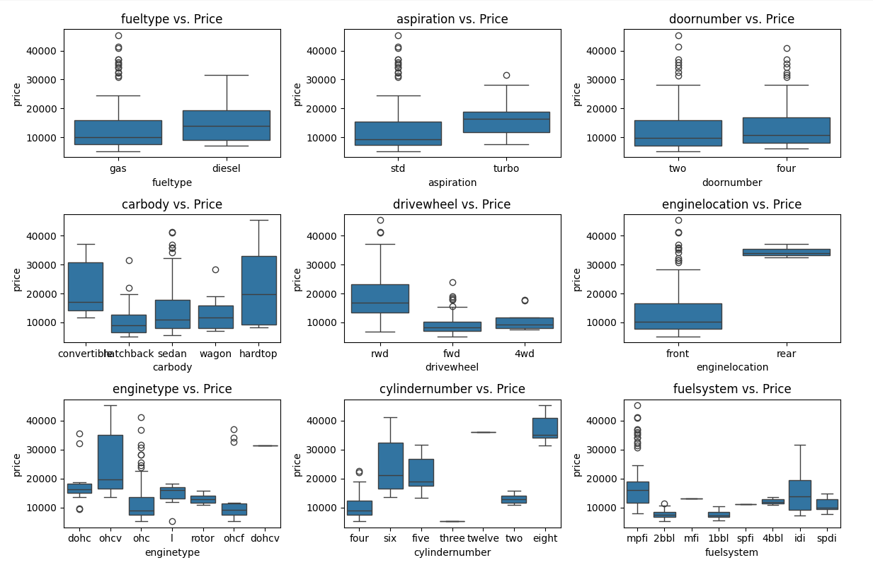
Box Plots of Price Distributions Across Categories
Car Body Styles
Different car body styles, such as sedans, SUVs, and coupes, can significantly affect the pricing of vehicles in the market.
Engine Types
The type of engine, including electric, hybrid, and gasoline, influences vehicle prices due to performance and efficiency.
Price Correlations
Understanding how body styles and engine types correlate with pricing is crucial for effective market analysis and consumer choices.
Notes:
In this slide, we will present examples of how car body styles and engine types affect prices. Understanding these correlations is essential for market analysis.

Slide 25
Correlation Analysis: Unveiling Relationships
Notes:
In this section, we will conduct a detailed correlation analysis to uncover relationships between numerical features of car models.

Slide 26
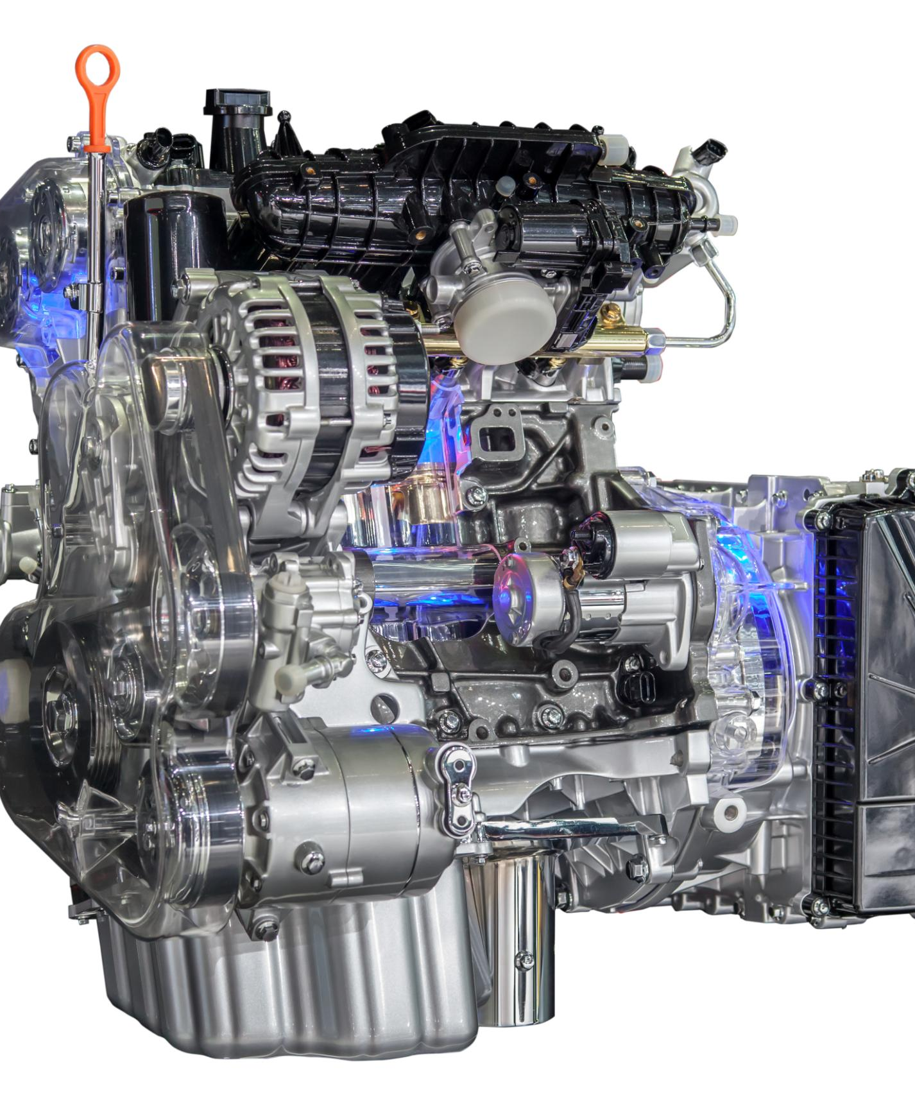
Example: Positive Correlation Between Engine Size and Horsepower
Understanding Engine Size
Engine size, measured in liters, influences the amount of fuel and air mixture for combustion, affecting overall power output.
Horsepower Explained
Horsepower is a measure of the engine's power and performance capabilities, directly tied to its size and design.
Impact on Vehicle Performance
Larger engines typically produce more horsepower, leading to enhanced acceleration and overall vehicle performance.
Notes:
We will examine an example illustrating the positive correlation between engine size and horsepower, showcasing how these features impact vehicle performance.

Slide 27
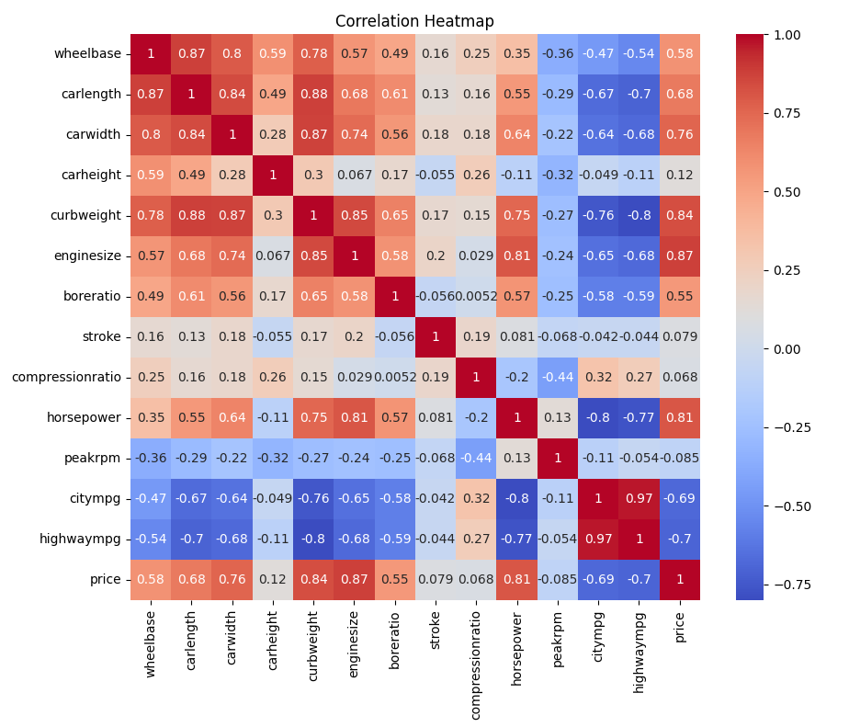
Visual: Simplified Correlation Heatmap
Purpose of Heatmap
The heatmap visually represents the correlation between numerical features, making complex data relationships easier to understand.
Key Numerical Features
It highlights the key numerical features analyzed, helping viewers identify patterns and correlations at a glance.
Analysis Overview
This overview serves as a quick reference for understanding how different features relate to one another in the dataset.
Notes:
This slide will display a simplified correlation heatmap to provide a clear overview of the relationships between key numerical features.

Slide 28
Linear Regression Modeling: Predicting the Price
Notes:
This section introduces linear regression modeling as a means to predict car prices based on various features, offering insights into the factors influencing value.

Slide 29
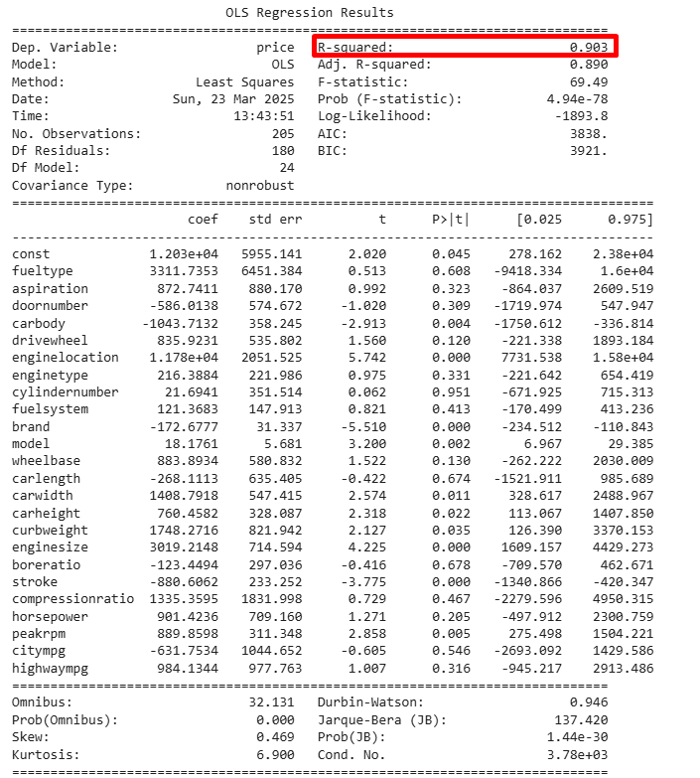
Linear Regression Model of Car Price Based on Features
Predicting Car Prices
The linear regression model helps in predicting car prices by analyzing key features such as mileage, age, and brand.
Understanding Price Dynamics
This model provides a framework to understand how various features influence car prices and market trends.
Notes:
We will present a linear regression model that illustrates how car prices can be predicted based on key features, providing a framework for understanding price dynamics.

Slide 30
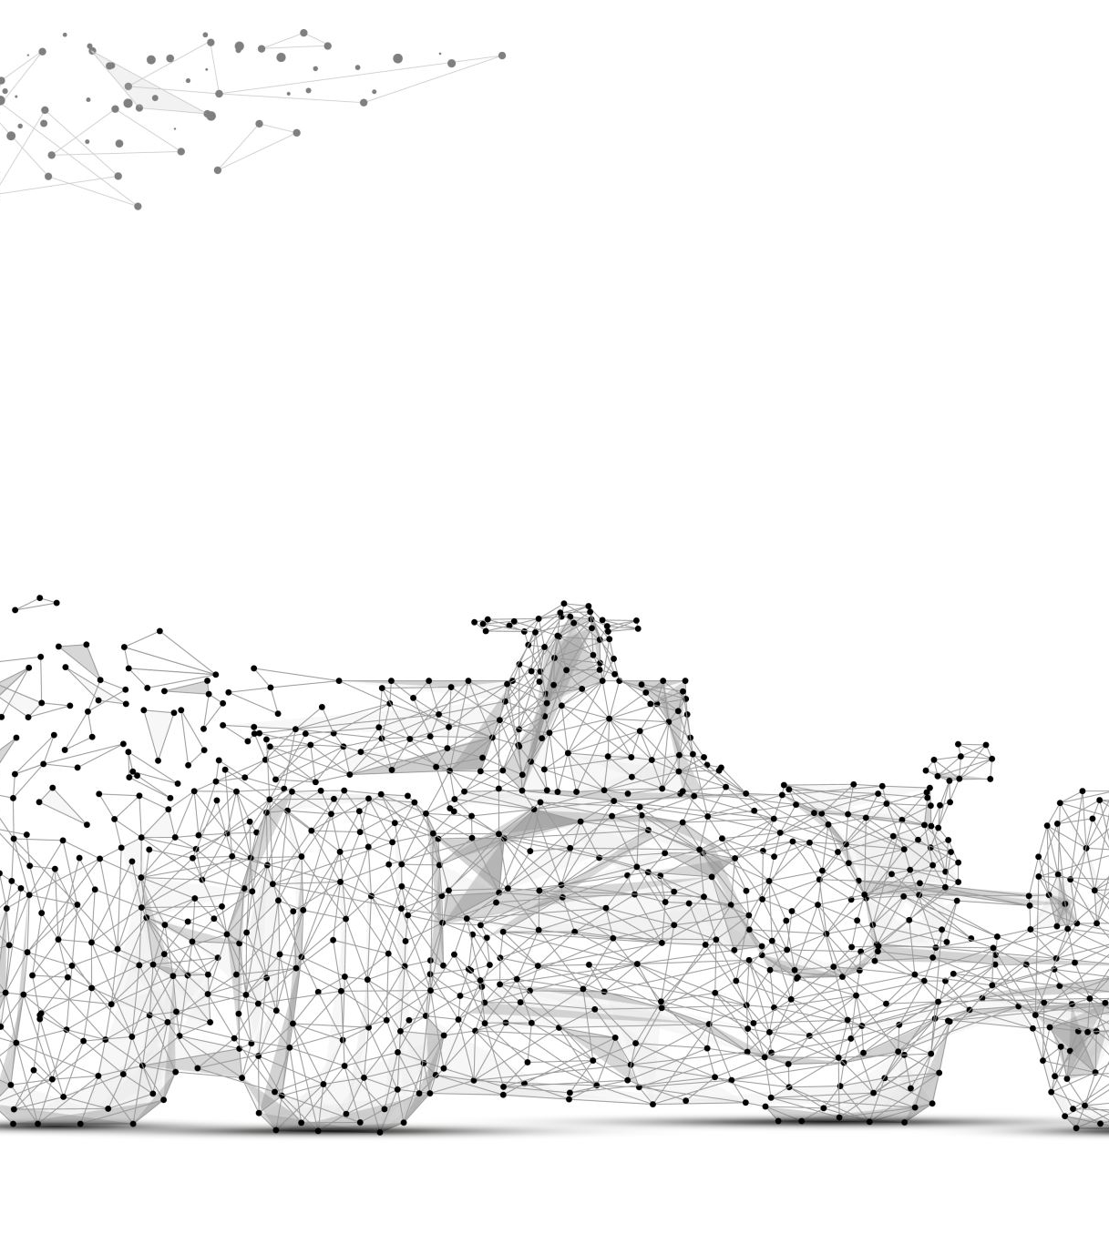
Conclusion
This linear regression model has a relatively high R-squared, indicating that the model fits the data well.
Many independent variables are statistically significant (p < 0.05), suggesting that they have a significant impact on car prices.
Variables such as engine size (enginesize), curb weight (curbweight), car width (carwidth), and car brand (brand) have a large impact on car prices.
Notes:
In conclusion, we will recap our main findings and discuss the influential features on car prices, trends in consumer preferences, and insights that can guide car buying, selling, or design decisions.

